Slide 1

MRA Project-1 Automobile Parts Manufacturing Company Transaction Data
Submitted by: Atul Yadav
Batch: PGP DSBA Feb 23.B G3

Slide 2
Agenda
Executive Summary of the data
Exploratory Data Analysis
RFM Analysis
Customer Segmentation using RFM
Inferences/Recommendation

Slide 3
Executive Summary
Data: from 06-01-2018 to 31-05-2020
Objective: Project involves conducting a thorough analysis of 3 years transaction data for an automobile parts manufacturing company. Our task is to find the underlying buying patterns of the customers, provide the company with suitable insights about their customers, and recommend customized marketing strategies for different segments of customers.
Dataset: 2747 Rows, 20 columns,
Missing values : None
Duplicate values: None
The exploratory analysis and insights provide a clear understanding of the data and highlight the key trend and pattern in sales.
RFM Analysis was performed to identify the various customer segments on basis of transactions done by the customers.
This analysis helped to identify the customer segments, which can be used to create customised marketing strategy.

Slide 4
Contents
Executive Summary of the data
Problem statement
Executive Summary & Data Dictionary
Assumptions about data
Exploratory Analysis & Insights
Country and City Sales
Yearly, Quarterly, Monthly, Weekday Trends in Sales count
Product line wise sales
Avg. order quantity and price as per dealsize
Summary and Recommendations
RFM Analysis
RFM Analysis Meaning
MRA KNIME WorkFlow & Qutput Table
Top customers as per 4 categories: Best, Loyal, Churn and Lost
Summary

Slide 5
Problem Statement
An automobile parts manufacturing company has collected data on transactions for 3 years. They do not have any in-house data science team, thus they have hired you as their consultant. Your job is to use your data science skills to find the underlying buying patterns of the customers, provide the company with suitable insights about their customers, and recommend customized marketing strategies for different segments of customers.

Slide 6
Data Dictionary
Column Name | Description
ORDERNUMBER | This column represents the unique identification number assigned to each order.
QUANTITYORDERED | It indicates the number of items ordered in each order.
PRICEEACH | This column specifies the price of each item in the order.
ORDERLINENUMBER | It represents the line number of each item within an order.
SALES | This column denotes the total sales amount for each order, which is calculated by multiplying the quantity ordered by the price of each item.
ORDERDATE | It denotes the date on which the order was placed.
DAYS_SINCE_LASTORDER | This column represents the number of days that have passed since the last order for each customer. It can be used to analyze customer purchasing patterns.
STATUS | It indicates the status of the order, such as "Shipped," "In Process," "Cancelled," "Disputed," "On Hold," or "Resolved"
PRODUCTLINE | This column specifies the product line categories to which each item belongs.
MSRP | It stands for Manufacturer's Suggested Retail Price and represents the suggested selling price for each item.
PRODUCTCODE | This column represents the unique code assigned to each product.
CUSTOMERNAME | It denotes the name of the customer who placed the order.
PHONE | This column contains the contact phone number for the customer.
ADDRESSLINE1 | It represents the first line of the customer's address.
CITY | This column specifies the city where the customer is located.
POSTALCODE | It denotes the postal code or ZIP code associated with the customer's address.
COUNTRY | This column indicates the country where the customer is located.
CONTACTLASTNAME | It represents the last name of the contact person associated with the customer.
CONTACTFIRSTNAME | This column denotes the first name of the contact person associated with the customer.
DEALSIZE | It indicates the size of the deal or order, which are the categories "Small," "Medium," or "Large."

Slide 7
Assumptions
The data represents various details of transactions done by customers of an automobile part manufacturing company on various dates.
Each entry in the data represents a sales transaction with customer.
The first column in the data represents the unique identification number assigned to each order. This also specifies frequency
The fifth column represents the total sales amount for each order, which specifies the monetary value.
The seventh column represents the number of days that have passed since the last order for each customer, which specifies the recency value.
For analysis, we have considered only “Shipped- Status” rows, as they constitute for 92.44% of data.

Slide 8
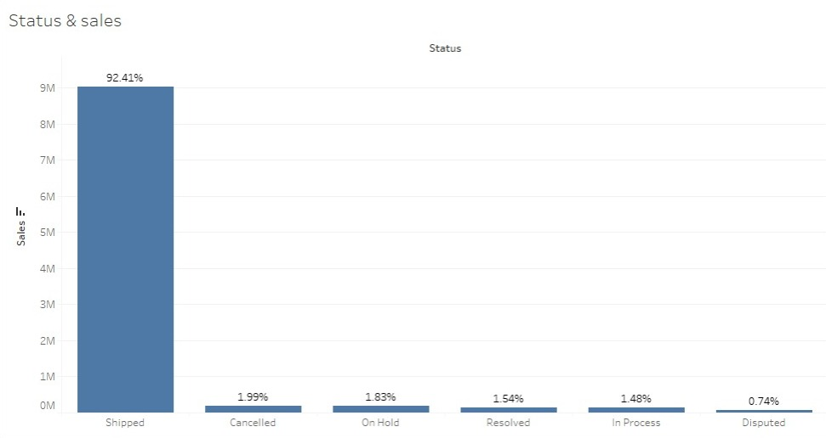
Order status
Above 92% of data is shipped, wheres as less than 4.5% of data is either cancelled, on hold or disputed.
Hence, we have considered only shipped status data for analysis

Slide 9
Exploratory Data Analysis
Country and City Sales
Yearly, Quarterly, Monthly, Weekday Trends in Sales count
Product line wise sales
Avg. order quantity and price as per dealsize
Summary and Recommendations

Slide 10
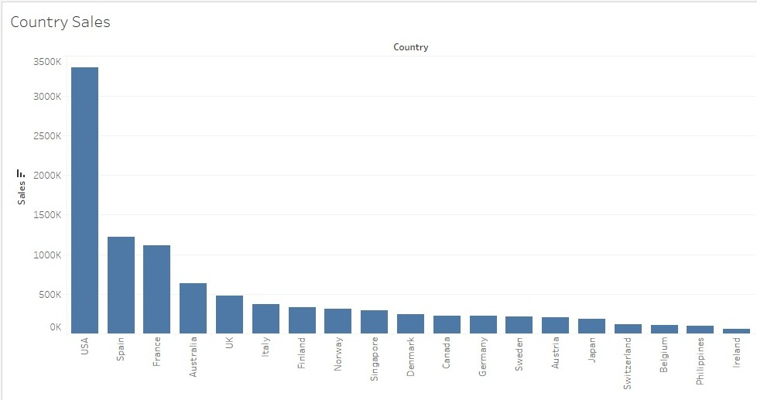
Country Sales:
Top 3 countries with highest sales are USA, Spain and France
Approx. 58% of sales are done in top 3 countries.
Bottom 3 countries as per sales are Belgium, Philippines and Ireland

Slide 11
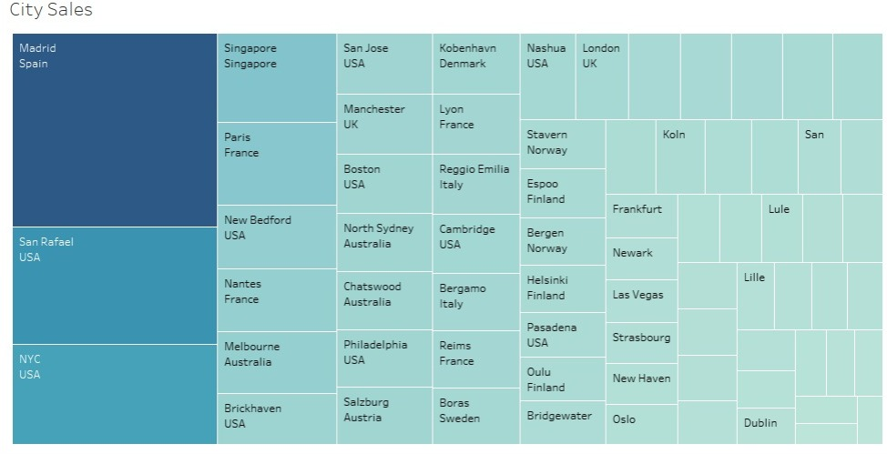
City Sales:
Madrid, San Rafael, NYC are the top 3 sales cities.
Madrid has more than 11% sales among 71 cities.

Slide 12
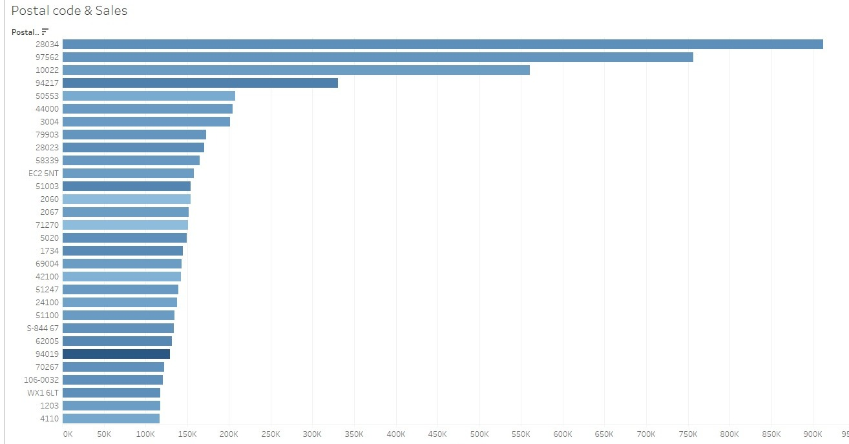
Sales as per Postal code
Postal code: 28034 has highest sales
Orders from postal code WX16LT and S-84467 has 42.72% and 36.28% cancellation in their order respectively.

Slide 13
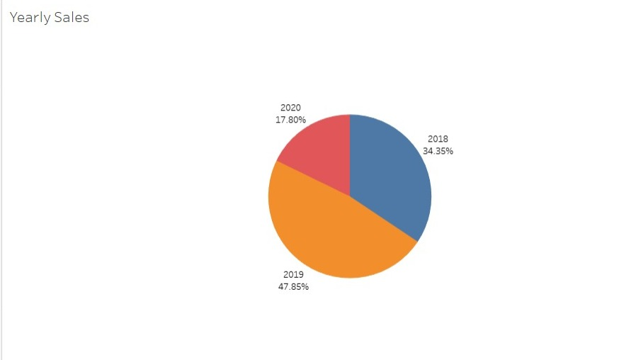
Yearly Sales
There is gradual increase in sales every year.
Data is till May 2020, thats why sales contribution percentage of 2020 is low.
But on quarterly or monthly basis, we can observe gradual growth in sales in 2020 compared to other years

Slide 14
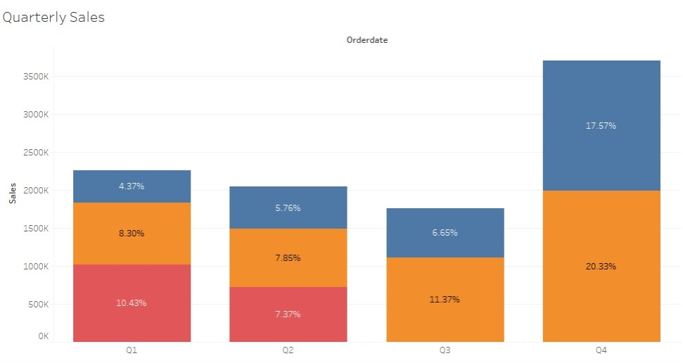
Quarterly Sales
Q4 has highest sales contibution, backed by Q1.
Q3 has comparatively lower sales because data is not available after May 2020

Slide 15
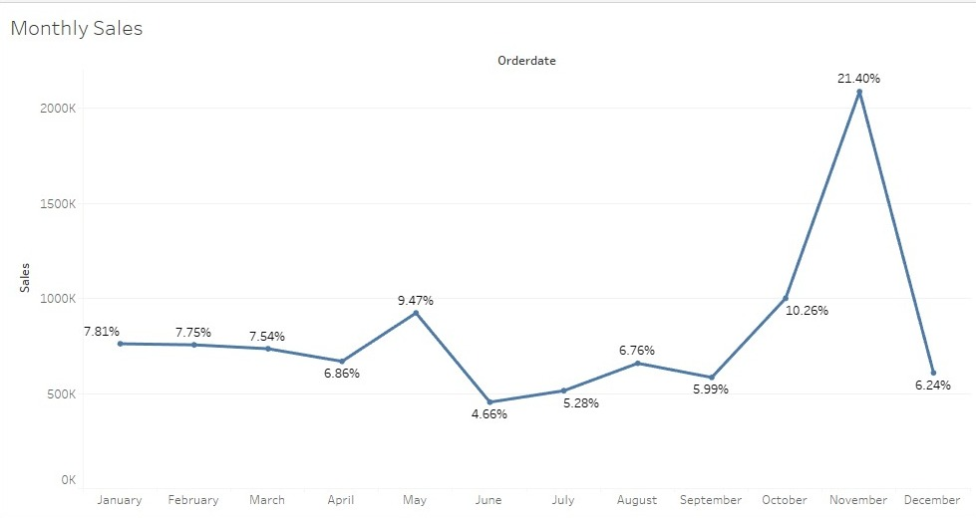
Monthly Sales
November being the highest sales contributor while June has the lowest sales.

Slide 16
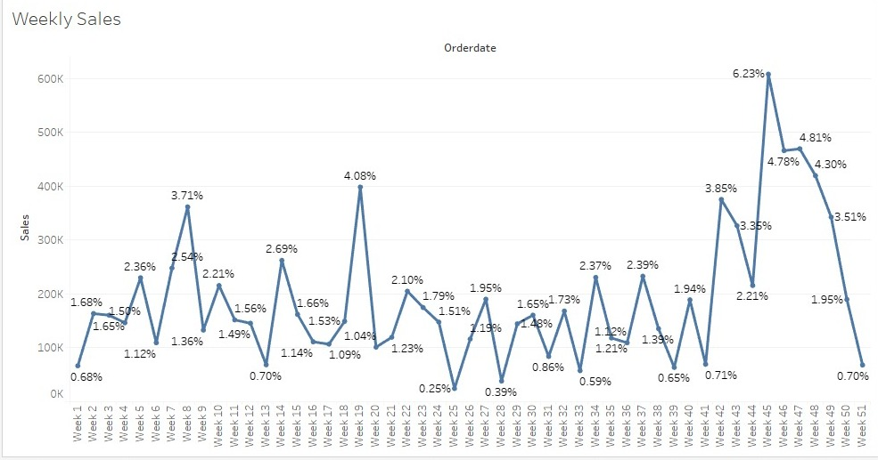
Weekly Sales
On weekly chart, we can obeserve an upward trend.

Slide 17
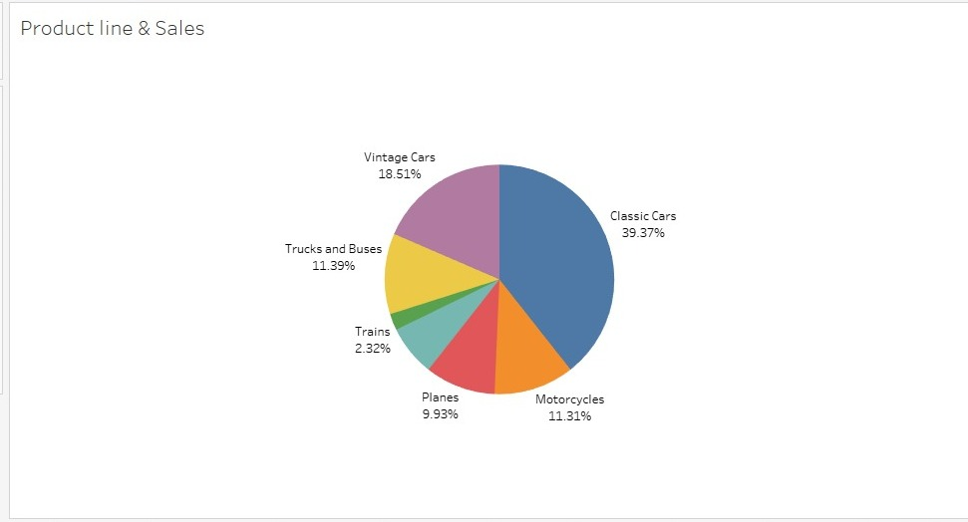
Sales as per product line
Classic and Vintage cars have the highest sales contribution, approx. 60% of sales
Trains product line has lowest contribution

Slide 18
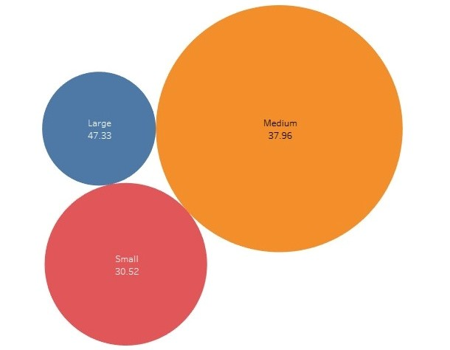
Dealsize and avg. quantity:
As expected, average order quantity for are as per deal size.
Large has 47.33, medium has 37.96 and small has 30.52 avg. order quantity

Slide 19
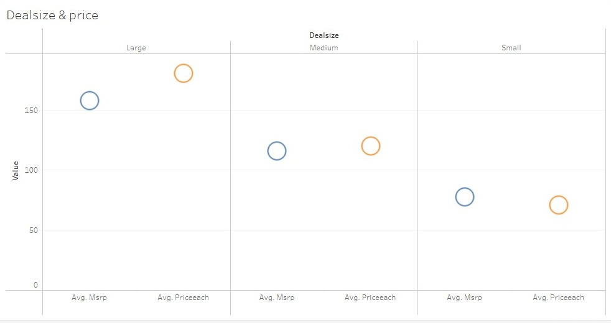
Avg. price as per Dealsize
Avg. Msrp is higher than avg. Price in small dealsize
Whereas, Avg. Price is higher than avg. Msrp in large and medium dealsize

Slide 20
Summary
USA, Spain and France are top 3 countries as per sales
Madrid has the highest sales throughout 3 years
Orders from postal code WX16LT and S-84467 has 42.72% and 36.28% cancellation in their order respectively.
There is an gradual increase in sales every year. The data for year 2020 is only till May month.
Q4 has highest overall sales contribution. And we can observe yearly increase in sales of Q1.
November (21.40%) has the highest sales contribution, while June (4.66%) has lowest contribution.
Overall highest Sales are seen in weeks 8, 19, 42-49 weeks.
Major sales are done in Classic cars and Vintage cars category.
Avg. order quantity for large, medium and small dealsize are 47.33, 37.96, 30.52.
For small dealsize, avg. Msrp is higher than avg. Price.
Highest difference in avg. Msrp (157.7) and avg. Price (180) is seen in Large dealsize.

Slide 21
Recommendation:
Focus marketing strategy mainly for USA, Spain and France customer
Evaluate the reasons behind the so high rate cancellation of shipment for postal code WX16LT and S-84467 and if the problem is at customer end, then we need to blacklist those postal code orders.
We can plan exclusive marketing strategy and campaigns for Q4 and try to replicate its sales process for other 3 quarters.
We need to provide some offer to increase sales in June.
We can check if we can accomodate some offer for train parts or combine it with some other product line to increase its sales.
For small dealsize, we need to re-evaluate our strategy. As avg Msrp is higher in that category.
Keep in mind the limited data for 2020 while making sales and marketing decisions.

Slide 22

RFM Analysis
RFM Analysis Meaning​
MRA KNIME WorkFlow & Qutput Table

Slide 23
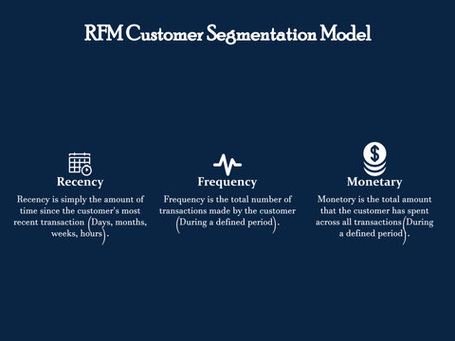
Definition of RFM:
RFM analysis is a type of customer segmentation and behavioral targeting used to help businesses rank and segment customers based on the recency, frequency, and monetary value of a transaction.

Slide 24
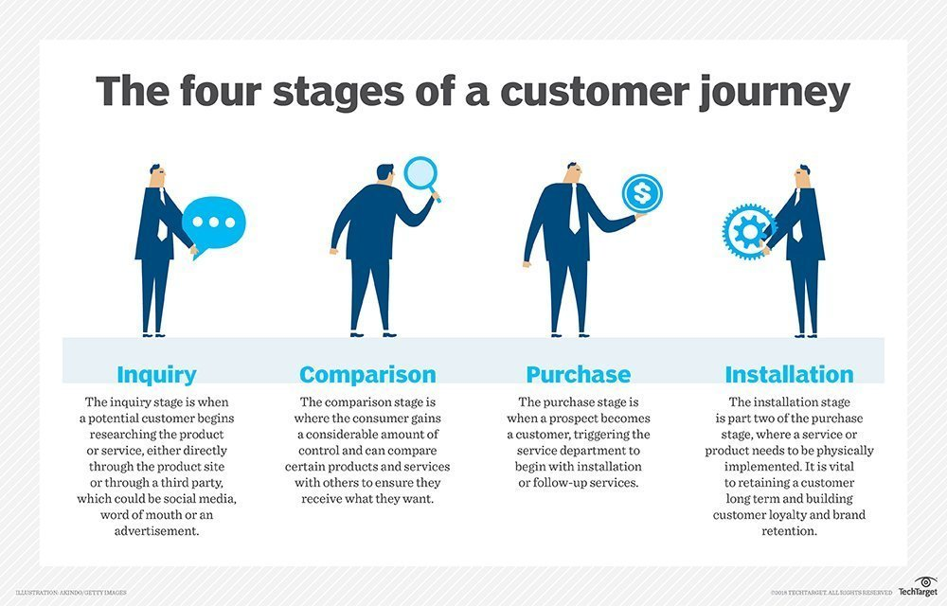
Recency, Frequency and Monetary
RFM analysis ranks each customer on the following factors:
Recency: How recent was the customer's last purchase? Customers who recently made a purchase will still have the product on their mind and are more likely to purchase or use the product again.
Frequency: How often did this customer make a purchase in a given period? Customers who purchased once are often are more likely to purchase again. Additionally, first time customers may be good targets for follow-up advertising to convert them into more frequent customers.
Monetary: How much money did the customer spend in a given period? Customers who spend a lot of money are more likely to spend money in the future and have a high value to a business.

Slide 25
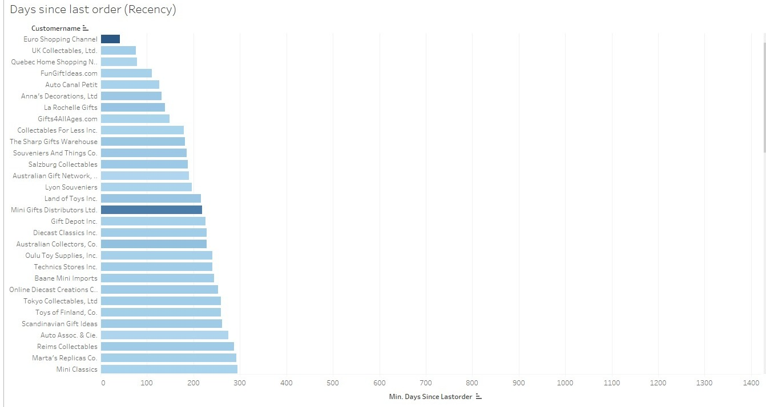
Recency

Slide 26
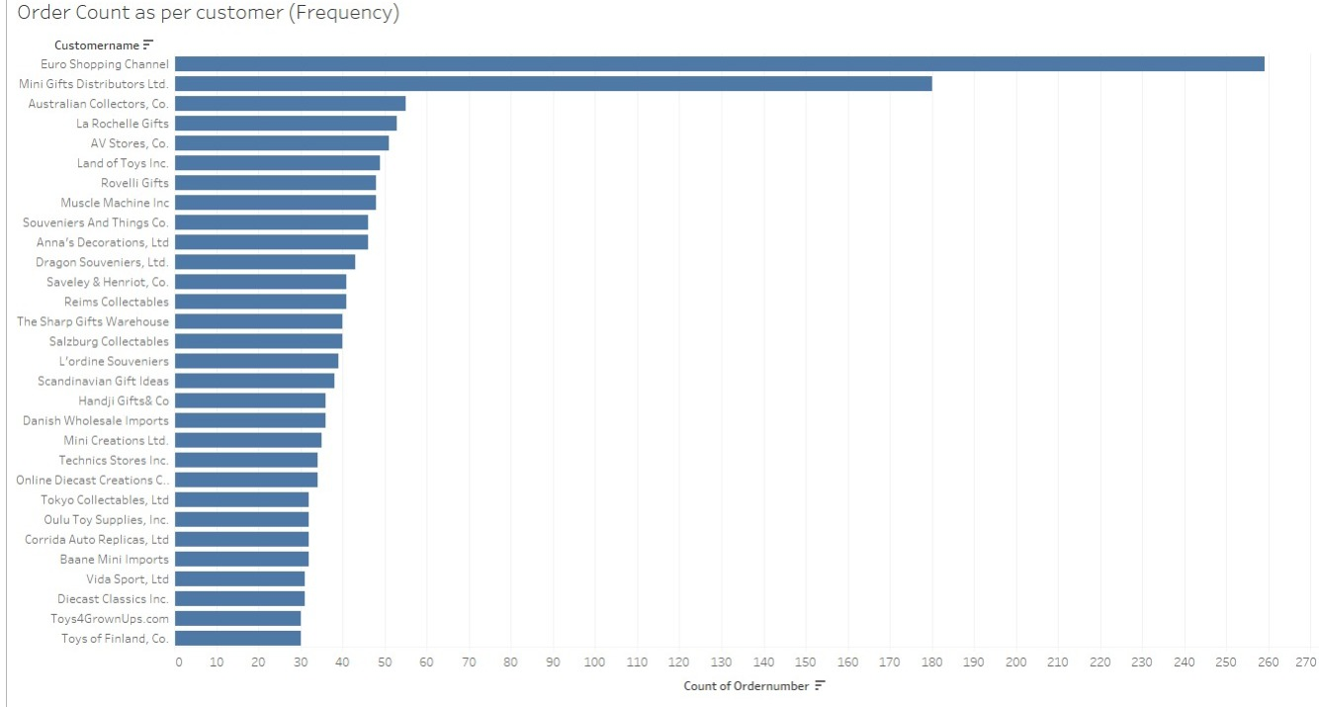
Frequency

Slide 27
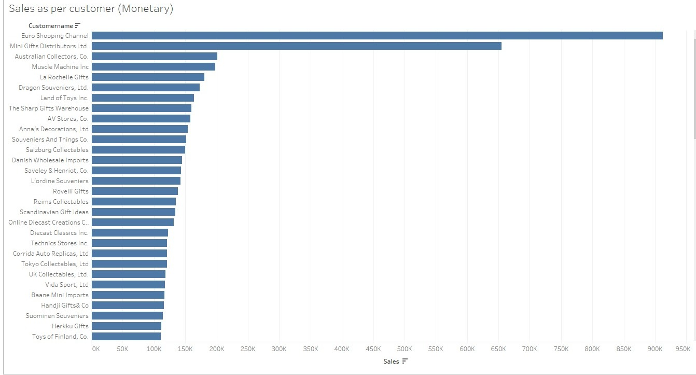
Monetary

Slide 28
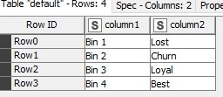
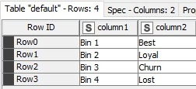
Binned
Frequency and Monetary
Recency

Slide 29
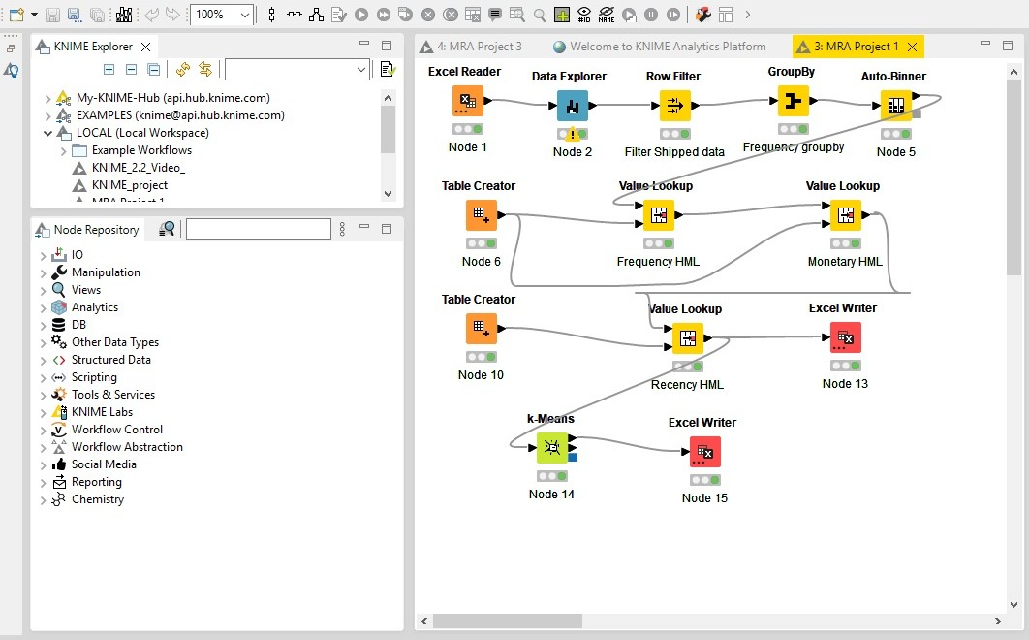
MRA KNIME Workflow

Slide 30
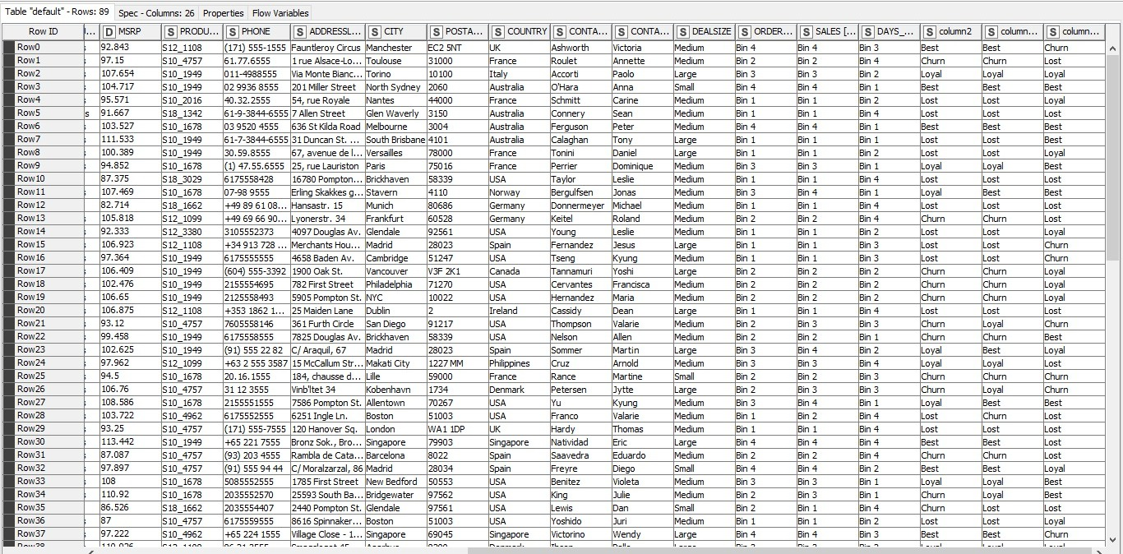
RFM table output

Slide 31
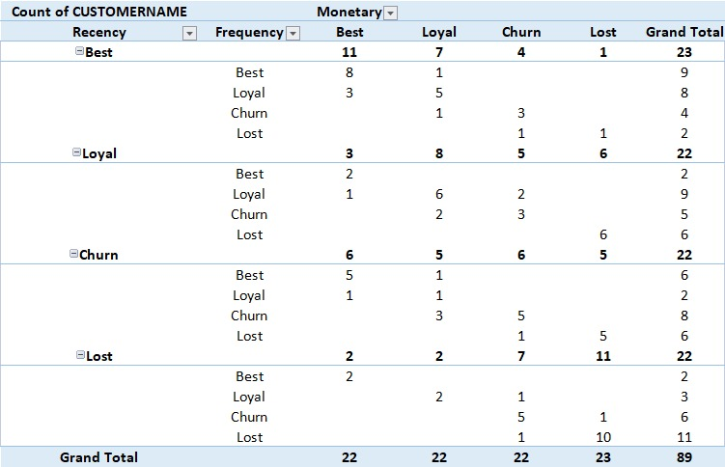
Customer Segmentation as per RFM Analysis

Slide 32
Top best customers
CUSTOMERNAME | ORDERNUMBER | SALES | DAYS_SINCE_LASTORDER | Recency | Frequency | Monetary
Anna's Decorations, Ltd | 46 | 153996.13 | 131 | Best | Best | Best
Australian Collectors, Co. | 55 | 200995.41 | 229 | Best | Best | Best
La Rochelle Gifts | 40 | 136340.21 | 139 | Best | Best | Best
Land of Toys Inc. | 35 | 118711.78 | 216 | Best | Best | Best
Mini Gifts Distributors Ltd. | 178 | 647596.31 | 219 | Best | Best | Best
Online Diecast Creations Co. | 34 | 131685.3 | 253 | Best | Best | Best
Salzburg Collectables | 40 | 149798.63 | 188 | Best | Best | Best
Technics Stores Inc. | 34 | 120783.07 | 241 | Best | Best | Best

Slide 33
Top Loyal customers
CUSTOMERNAME | ORDERNUMBER | SALES | DAYS_SINCE_LASTORDER | Recency | Frequency | Monetary
Auto Canal Petit | 27 | 93170.66 | 127 | Best | Loyal | Loyal
Baane Mini Imports | 32 | 116599.19 | 245 | Best | Loyal | Best
Diecast Classics Inc. | 29 | 115971.34 | 228 | Best | Loyal | Best
FunGiftIdeas.com | 26 | 98923.73 | 111 | Best | Loyal | Loyal
Oulu Toy Supplies, Inc. | 32 | 104370.38 | 241 | Best | Loyal | Loyal
The Sharp Gifts Warehouse | 28 | 102127.18 | 182 | Best | Loyal | Loyal
Tokyo Collectables, Ltd | 32 | 120562.74 | 259 | Best | Loyal | Best
Toys of Finland, Co. | 30 | 111250.38 | 259 | Best | Loyal | Loyal

Slide 34
Top customers on verge of lost
CUSTOMERNAME | ORDERNUMBER | SALES | DAYS_SINCE_LASTORDER | Recency | Frequency | Monetary
Collectable Mini Designs Co. | 25 | 87489.23 | 575 | Churn | Churn | Loyal
Daedalus Designs Imports | 20 | 69052.41 | 573 | Churn | Churn | Churn
Danish Wholesale Imports | 25 | 94950.12 | 579 | Churn | Churn | Loyal
Mini Caravy | 19 | 80438.48 | 447 | Churn | Churn | Churn
Motor Mint Distributors Inc. | 23 | 83682.16 | 484 | Churn | Churn | Churn
Osaka Souveniers Co. | 20 | 67605.07 | 563 | Churn | Churn | Churn
Petit Auto | 20 | 66560.57 | 426 | Churn | Churn | Churn
Vitachrome Inc. | 25 | 88041.26 | 432 | Churn | Churn | Loyal

Slide 35
Lost customers
CUSTOMERNAME | ORDERNUMBER | SALES | DAYS_SINCE_LASTORDER | Recency | Frequency | Monetary
Australian Collectables, Ltd | 18 | 50213.37 | 1018 | Lost | Lost | Lost
Auto-Moto Classics Inc. | 8 | 26479.26 | 1353 | Lost | Lost | Lost
Bavarian Collectables Imports, Co. | 14 | 34993.92 | 801 | Lost | Lost | Lost
Clover Collections, Co. | 16 | 57756.43 | 659 | Lost | Lost | Lost
Double Decker Gift Stores, Ltd | 12 | 36019.04 | 670 | Lost | Lost | Lost
Iberia Gift Imports, Corp. | 15 | 54723.62 | 904 | Lost | Lost | Lost
Mini Auto Werke | 7 | 23713.31 | 854 | Lost | Lost | Lost
Royale Belge | 8 | 33440.1 | 737 | Lost | Lost | Lost
Signal Collectibles Ltd. | 15 | 50218.51 | 836 | Lost | Lost | Lost
Toys4GrownUps.com | 17 | 60288.6 | 649 | Lost | Lost | Lost

Slide 36
Summary
The analysis identified the customers on basis of their transactions and segmented them into 4 major categories.
44 out of 89 customers are either on verge of churn or lost. We can do some digital activity (cold mail) and share some offer to atleast customers who are on verge of churn to retain them. As they are 25% of our customer base.
Accordingly, we are try to get upsale from the best customers.
We need to plan some marketing to move loyal customers to best customers.
Overall, the RFM analysis can help the company to better understand customer valuation, and to make informed decisions about marketing strategy.

Slide 37
THANK YOU

